Slide 1
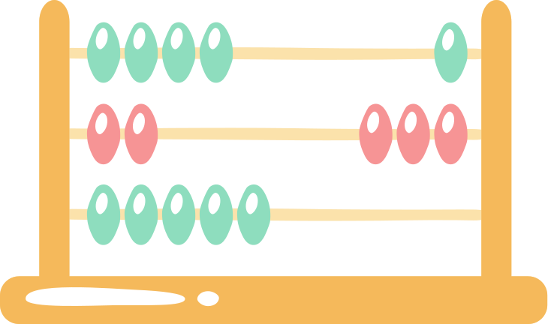
Presentation On
Insertion Sort Algorithm
Hafsa Ferdousi
2023-3-60-321
Department of CSE
East West University

Slide 2

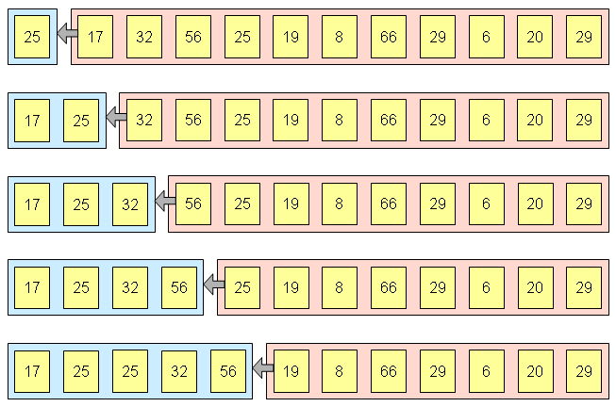
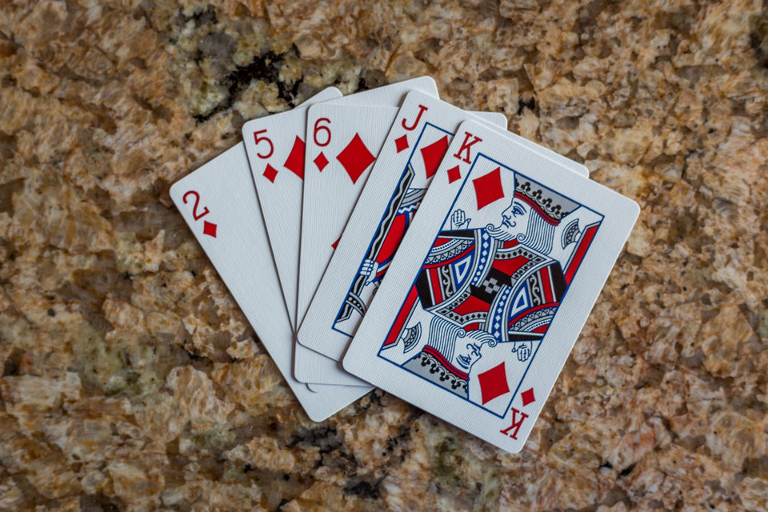
What is Insertion Sort Algorithm?
Insertion sort is a simple sorting algorithm that works by iteratively inserting each element of an unsorted list into its correct position in a sorted portion of the list.
Insertion sort is like sorting playing cards in your hands. You split the cards into two groups: the sorted cards and the unsorted cards. Then, you pick a card from the unsorted group and put it in the right place in the sorted group.

Slide 3

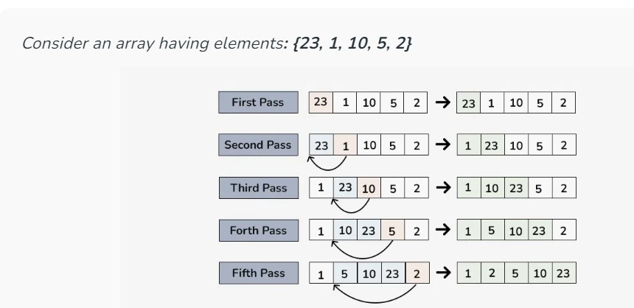
To achieve insertion sort, follow these steps:
Compare each other
1.We must start with the second element of the array as the first element in the array is assumed to be sorted.
2.Compare the second element with the first element and check if the second element is smaller than swap them.
3. Move to the third element and compare it with the second element, then the first element and swap as necessary to put it in the correct position among the first three elements.
4. Continue this process, comparing each element with the ones before it and swapping as needed to place it in the correct position among the sorted elements.
5.Repeat until the entire array is sorted.

Slide 4

Practical application on Insertion Sort Algorithm
There are 40 students, each with a different student ID. If we want to arrange ourselves in a row according to our IDs, we can easily use the insertion sort algorithm. Here is how we can do it:
1.First, we move to the first position in the row.
2.Then, we check the second position. If the student in the second position has a smaller ID than the student in the first position, they swap places.
3.Next, we check the third position. We compare the student in the third position with the one in the second position. If the IDs are in order, we move on to the fourth position. If not, we swap them until they are in the correct order.
4.We repeat this process, comparing each new position with the previous ones and making swaps as necessary until all students are in the correct order.
.

Slide 5




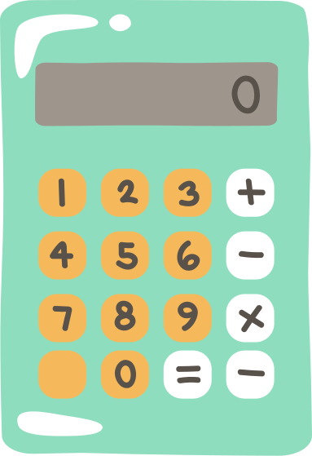

3, 23, 43, 63, 83
Thank You
Everyone.

